Slide 1
Data Analysis of Soil Parameters at a Local Land Preserve
Owen Galicia, Jack Colwell, Lilu Smith, Santiago Gutierrez Morales

Slide 2
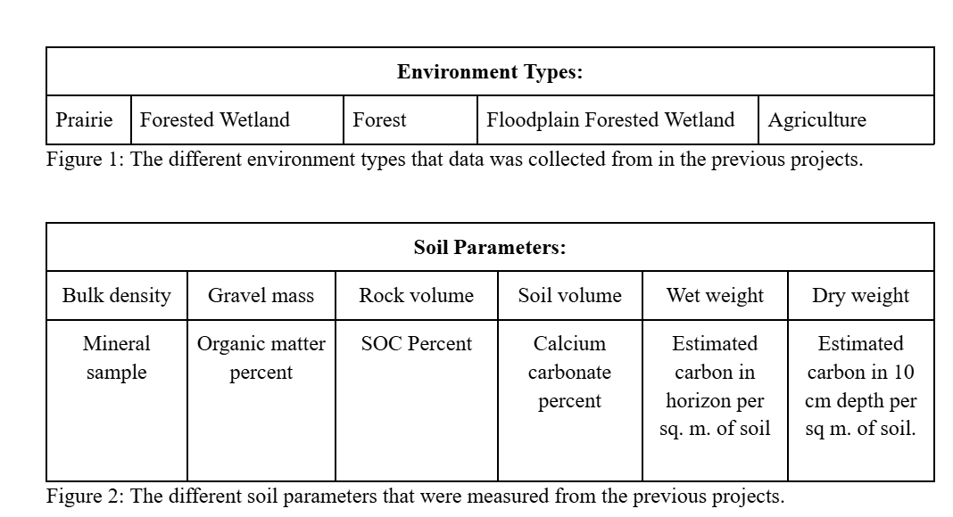
Introduction
Data from "Environmental Restoration Target Estimation Around Engquist Nature Preserve"; previous research by Jack Colwell
Collected at the Dale B. Engquist Preserve, operated by Shirley Heinze Land Trust (SHLT).
Soil samples were collected from various environment types at Engquist and analyzed for different soil parameters shown below

Slide 3
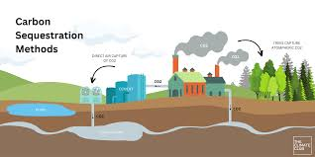
Introduction Cont.
Developed a predictive model for SOC content in the dataset to save time and costs of testing
The model showed that one soil parameter can accurately predict another, including its magnitude and direction
SOC levels in Indiana can range from less than 1% to over 10%, particularly in Northwestern Indiana muck soils.
The project is important due to the role of SOC in agriculture and climate change (global warming)
Helps farmers make informed decisions about crops and soil management
Soils store a significant amount of organic carbon, which can either be released as CO2 if soils degrade or prevented if managed sustainably, influencing the global carbon cycle.

Slide 4
Hypothesis
The research question is: Which variables from the existing dataset can be used to model SOC?
The null hypothesis (H0): There are no variables that can accurately predict SOC.
The alternative hypothesis (Ha): At least two variables are significant predictors of SOC.

Slide 5
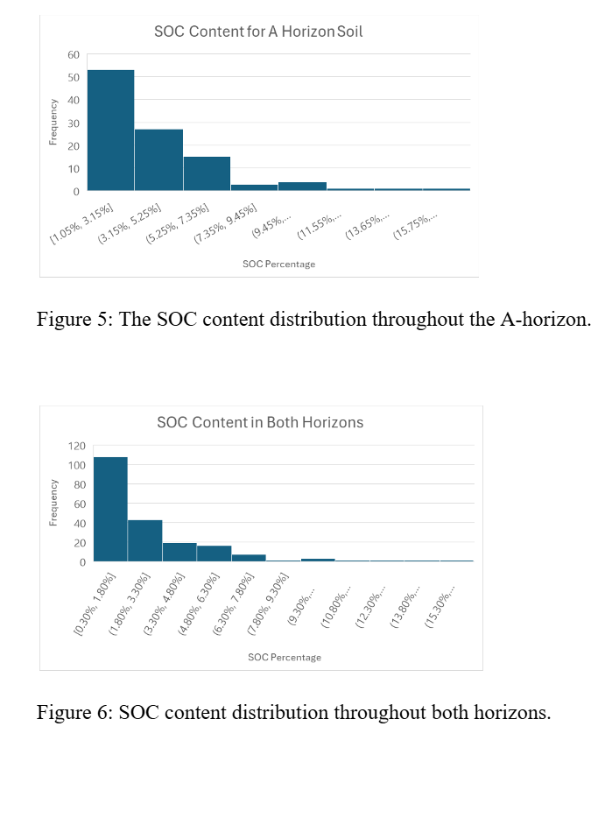
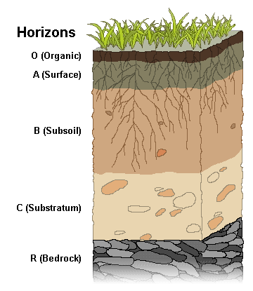
Data and Methods
Correlation matrix was developed
Predictive models (linear regression, decision tree, LASSO, and random forest) were built based on the correlation matrix outcomes

Slide 6
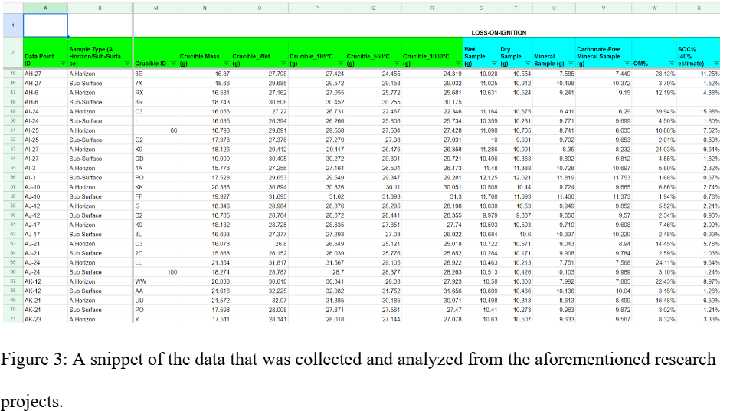
Dataset

Slide 7
Data and Methods Cont.
The data was divided into two subsets for analysis:
One subset with sampling points containing bulk density measurements (only A horizon data).
Another subset with remaining data (only subsurface horizon data, without bulk density measurements).
Analysis included creating a five-number summary for all variables and an initial correlation matrix for both datasets.
Histograms of the Soil Organic Carbon (SOC) content were created to examine data distribution.

Slide 8
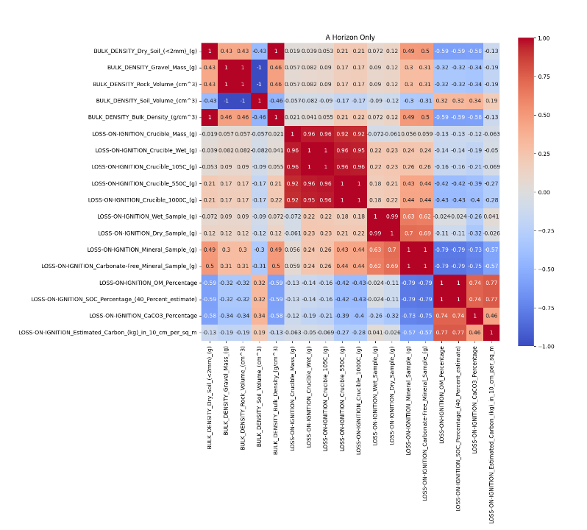
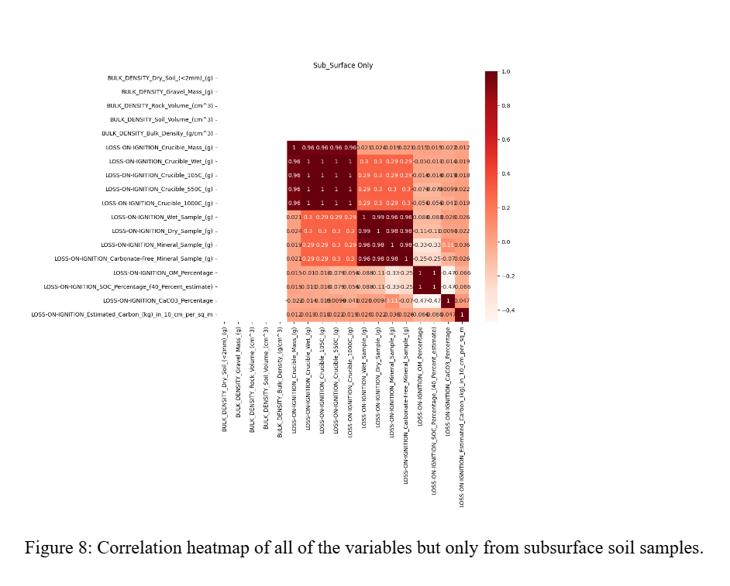
Figures

Slide 9
Libraries
Pandas for data manipulation and cleaning.
NumPy for numerical computations.
Scikit-learn for implementing various machine learning models like regression, decision trees, and random forests.
Matplotlib and Seaborn for data visualization (e.g., histograms, correlation matrices).
Statsmodels for statistical modeling and hypothesis testing

Slide 10
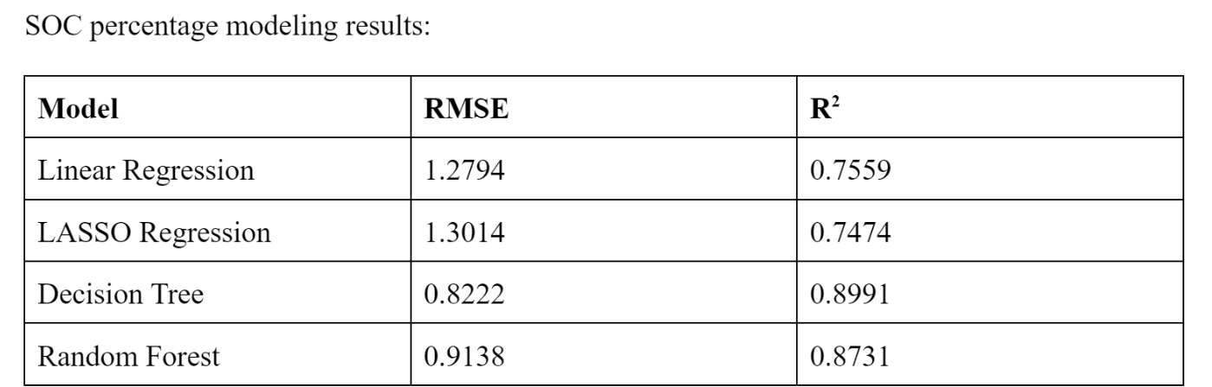
Results

Slide 11
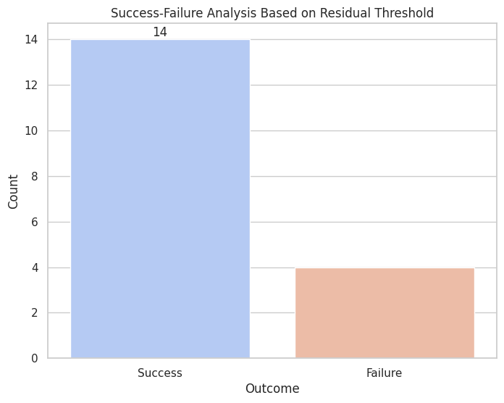
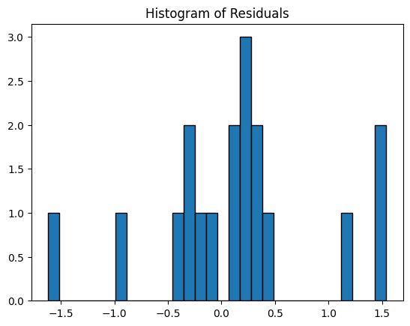
Random forest regression model results:

Slide 12
Discussion
Linear Regression
Established a baseline, highlighting significant relationships but limited predictive power.
LASSO Regression
Added regularization to simplify the model, balancing complexity and interpretability but slightly less accurate than linear regression.
Decision Trees
Captured nonlinear patterns but prone to overfitting, limiting generalization to new data.
Random Forest
Mitigated overfitting, captured complex relationships, and became the most reliable model, balancing accuracy and strength

Slide 13
Conclusion
SOC Prediction: The random forest model outperformed others
R²: 87.3%
RMSE: 0.9138
Demonstrating strong predictive accuracy and handling of overfitting.
Impact: Provide valuable insights for managing soil health and contribute to climate change mitigation strategies through better carbon content understanding.
Future Considerations: Ensure diverse soil datasets and careful sample selection to improve model generalization and reliability.
Application: Findings aid farmers, conservationists, and land management agencies in enhancing soil health and carbon solutions.

Slide 14
Works cited
9.1 Soil Profiles & Processes | Environmental Biology. n.d. Courses.lumenlearning.com. https://courses.lumenlearning.com/suny-environmentalbiology/chapter/9-1-soil-profiles-processes/.
Cutting, Benjamin J., Clement Atzberger, Asa Gholizadeh, David A. Robinson, Jorge Mendoza-Ulloa, and Belen Marti-Cardona. “Remote Quantification of Soil Organic Carbon: Role of Topography in the Intra-Field Distribution.” Remote Sensing 16, no. 9 (May 1, 2024): 1510. doi:10.3390/rs16091510.
Ellis, Elizabeth, and Keith Paustian. “Importance of On-Farm Research for Validating Process-Based Models of Climate-Smart Agriculture.” Carbon Balance & Management 19, no. 1 (May 29, 2024): 1–12. doi:10.1186/s13021-024-00260-6.
Purdue University Agricultural Communication. Soil organic matter matters. Indiana State Climate Office [Internet]. c2021 [cited 2024 Dec 2]. Available from: https://ag.purdue.edu/indiana-state-climate/research/farming-for-a-better-climate/f4abc-soil-organic-matter/
Weil, Ray R, and Nyle C Brady. Elements of the Nature and Properties of Soils. New York, Ny Pearson. 2019.

Slide 15
Any Questions?

